Slide 1
ELEMENTARY GRAPH ALGORITHMS
MADE BY : RITIKA SINGH
ROLL NO : 181210042
BRANCH : CSE, 2ND YEAR

Slide 2
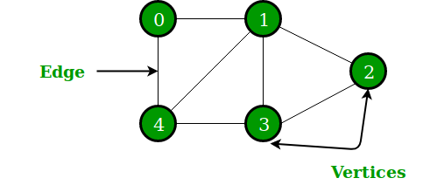
INTRODUCTION
What is a Graph ?
A graph G = (V, E)
where, V → set of vertices
E → set of edges

Slide 3
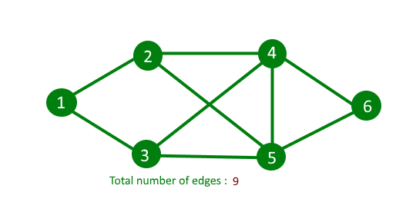
Types of Graphs :
1. Undirected Graphs
An undirected graph is a graph that has no orientation. That is the edge
(x, y) is identical to (y, x) i.e. they are not ordered pairs. The maximum
number of edges possible in an undirected graphs are n*(n-1)/2.
And the minimum number of edges in an undirected graphs are (n-1).

Slide 4
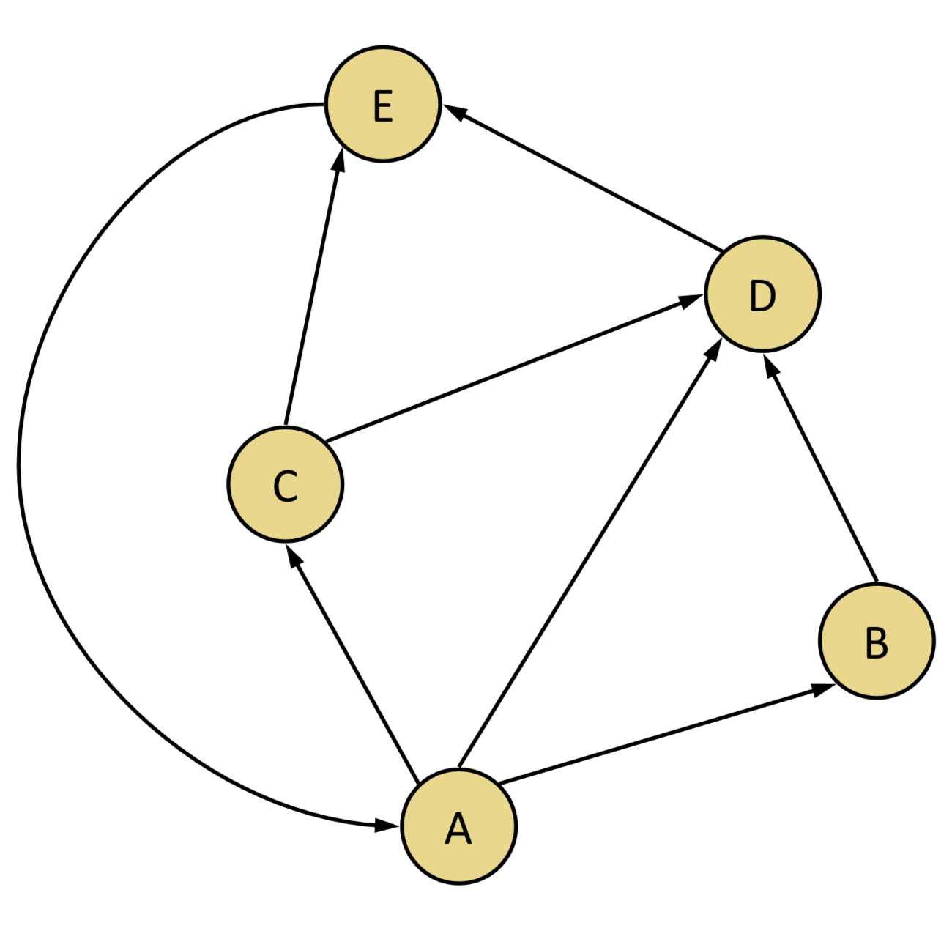
2. Directed Graphs
A graph with orientations. The edge pair (x, y) is not the same as (y, x) i.e. it is
an ordered pair. The maximum number of edges in a directed graph is
n*(n-1), (twice the number in undirected graphs).

Slide 5
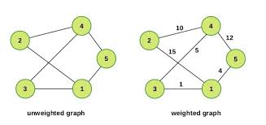
3. Weighted & Unweighted graphs
A weighted graph associates a value (weight) with every edge in the graph.
Words, cost or length can also be used instead of weights.
And, an unweighted graph does not associate any value (weight) with any
edge of the graph.

Slide 6
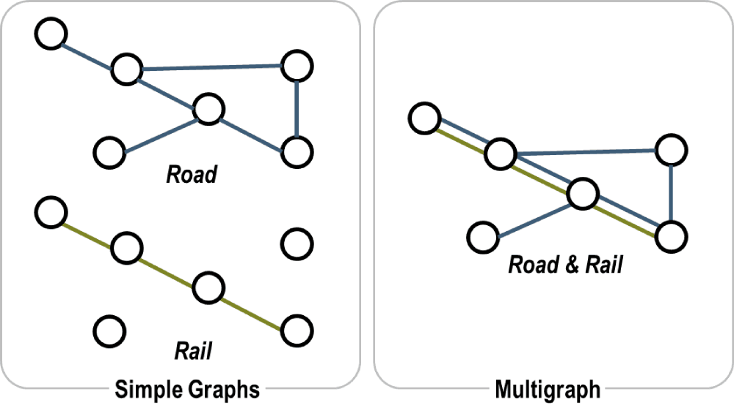
4. Multigraph & Simple Graph
A multigraph is an undirected graph in which multiple edges are allowed
(sometimes) loops. Multiple edges refer to two or more edges that connect
the same vertices.
A simple graph as opposed to a multigraph, is an undirected graph in which
both multiple edges and loops are disallowed.

Slide 7
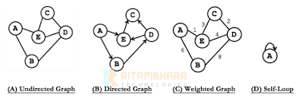
5. Other Variations
Well, there are many more types of graphs like Complete graphs, Connected &
Disconnected Graphs, Cyclic Graphs. But we will mostly deal with weighted &
unweighted or directed graphs.
Notes:
Disconnected Graphs. But we will mostly deal with weighted & unweighted or directed graphs.

Slide 8
Representation of Graphs
There are two standard ways to represent graphs, namely called as adjacency
list and adjacency matrix.
Adjacency List : The adjacency-list representation of a graph G = (V, E) consists of an array Adj of
V lists, one of each vertex in V. For each u in V, the adjacency list Adj[u] contains all the
vertices such that there is an edge u in E. That is, Adj[u] consists of all the vertices
adjacent to u in G.
Adjacency Matrix : The adjacency-matrix representation of a graph G consists of a V×V matrix A_{ij}
such that :
A_{ij} = 1, if (i, j) ϵ E
0, otherwise
Notes:
V lists, one for each vertex in V . For each u in V , the adjacency list Adj[u] contains all the vertices such that there is an edge u in E. That is, Adj[u] consists of all the vertices adjacent to u in G.

Slide 9
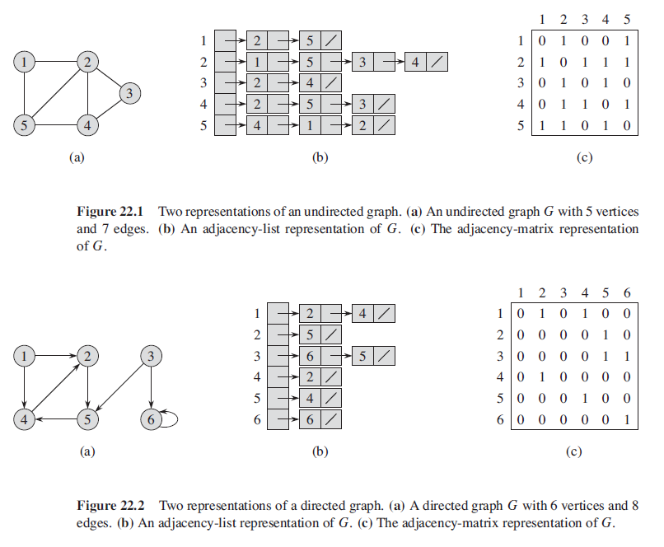

Slide 10
GRAPH SEARCH ALGORITHMS
Given a Graph G = (V, E) directed or undirected. The goal is to methodically explore every vertex and every edge.
There are two well known graph search algorithms :
ALGORITHMS
BREADTH-FIRST SEARCH
DEPTH-FIRST SEARCH

Slide 11
BREADTH-FIRST SEARCH ALGORITHM

Slide 12
INTRODUCTION
Breadth-first search (BFS) is an algorithm for traversing or searching tree or graph data structures. We need to know two important terminology to understand the process of BFS traversal.
Visiting a Vertex : This mean we are currently present on that vertex in the graph or tree.
Exploration of a Vertex : This refers to visiting all the adjacent vertices of the source vertex or the visiting vertex.

Slide 13
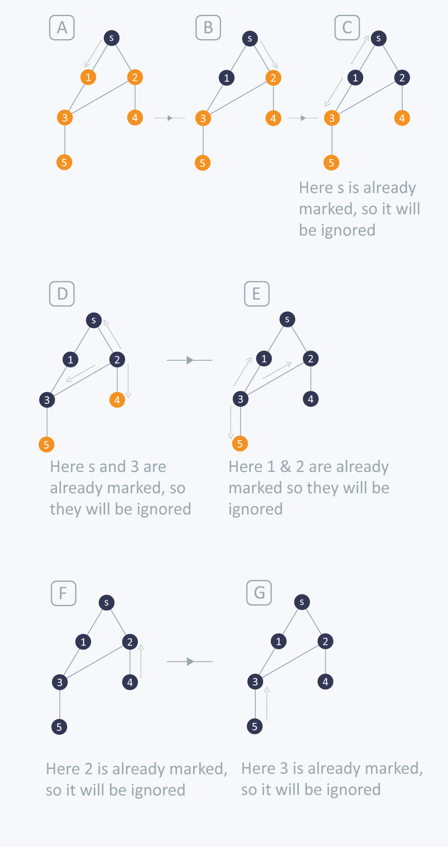
BREADTH-FIRST TRAVERSAL (BFS) :
The first step is to pick any vertex, that becomes are start vertex.
Next step is to explore the current vertex we are on and explore all the adjacent vertices to it.
We repeat the above two steps until all the vertices of the graph are visited at least once.
We have explained the above steps using an
example. Note that the vertex marked with
dark colour are the visited or explored
vertices.
Notes:
example. Note that the vertex marked with dark colour are the visited or explored vertices.

Slide 14
Like in previous example, in order to keep track of our BFS traversal we will use
different colour i.e. white, grey and black, to denote vertices with different attributes.
All vertices start out white. White represents un-visited or un-explored vertices.
A vertex becomes non-white if it discovered the first time. We associate grey for such vertices. Grey represents the visited or first-discovered vertices.
A vertex becomes black if it is explored and we are required to begin the exploration of it’s adjacent visited vertices. Black represents the vertices that are explored.
Notes:
white, grey and black, to denote vertices with different attributes.

Slide 15
ALGORITHM
The breadth-first search procedure assumes that the input graph
G = (V, E) is represented using adjacency lists.
We store the colour of each vertex u ϵ V in the attribute u.color and the predecessor of u in the attribute in u.π.
If u has no predecessor then u.π = NIL.
The attribute u.d holds the distance from the source s to vertex u.
The algorithm also uses first-in, first-out queue Q.

Slide 16
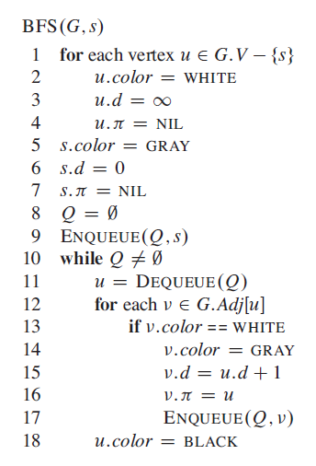
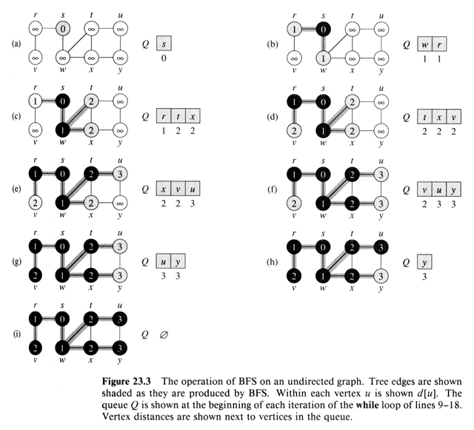

Slide 17
DEPTH-FIRST SEARCH ALGORITHM

Slide 18
INTRODUCTION
The strategy followed by depth-first search is, as its name implies, to search deeper in the graph whenever possible.
DEPTH-FIRST SEARCH TRAVERSAL (DFS):
Depth-first search explores edges out of the most recently discovered vertex v that still has un-explored edges leaving it.
Once all of v’s edges have been explored, the search “backtracks” to explore edges leaving the vertex from which v was discovered.

Slide 19
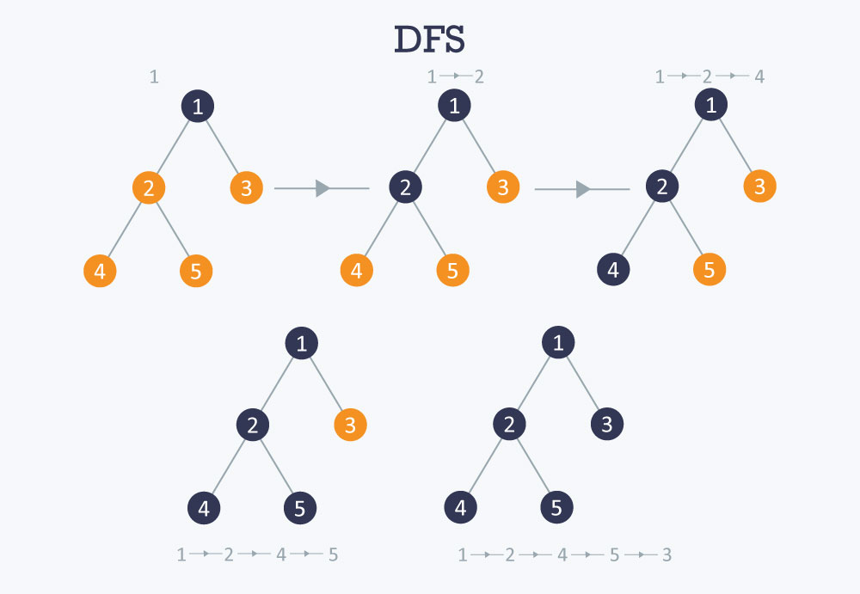

Slide 20
ALGORITHM
Whenever depth-first search discovers a vertex v during a scan of the adjacency list of an already discovered vertex u, it records this event by setting v’s predecessor attribute v.π to u.
The predecessor subgraph of a depth-first search slightly differently from that of a breadth-first search :
G_{π} = (V, E_{π})
where , E_{π} = {(v.π, v) : v ϵ V and v.π ≠ NIL}

Slide 21
Depth-first search also uses colours to mark the vertices with different
attributes.
Each vertex is initially white. White is used to represent the vertex which is un-visited and un-explored.
When the vertex is discovered and visited it’s marked non-white. Grey represents the vertex that is discovered or visited.
When all the adjacent vertices of the current discovered vertices are visited, the colour changes to black. Black is used to determine the exploration of vertex is completed or in other words, when the adjacency list of the vertex is completed.

Slide 22
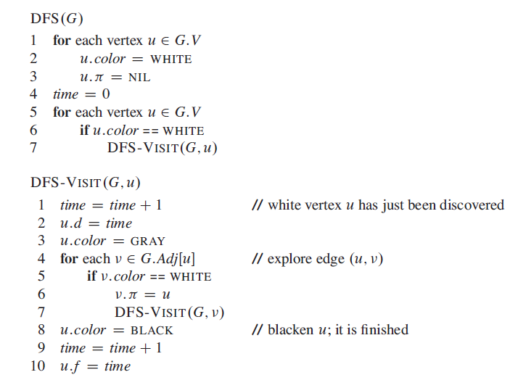

Slide 23
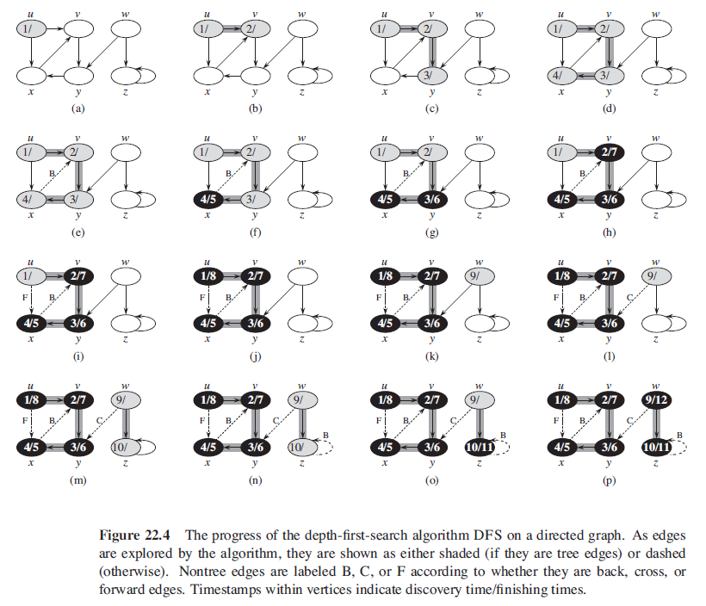

Slide 24
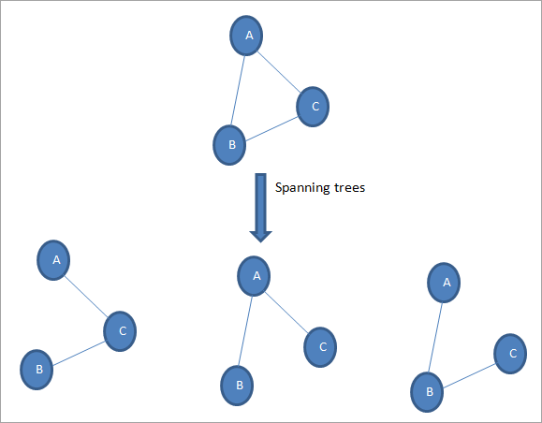

MINIMUM SPANNING TREES
What is a Spanning Tree ?
A spanning tree of a graph is a subgraph that consists of all
vertices and edges |E| = |V|-1.

Slide 25
How many such spanning trees can be formed ?
Suppose |V| = 6 and |E| = |V|-1 = 5, where V, E ϵ vertices and edges
respectively. Thus the possible combinations are :
N = ^{|V|}C_{|E|} = ⁶C₅
N = 6
NOTE : In case the total edges (in the graph) forms (m) cycles.
Then the possible combinations will be :
N = ^{|V|}C_{|E|} - m

Slide 26
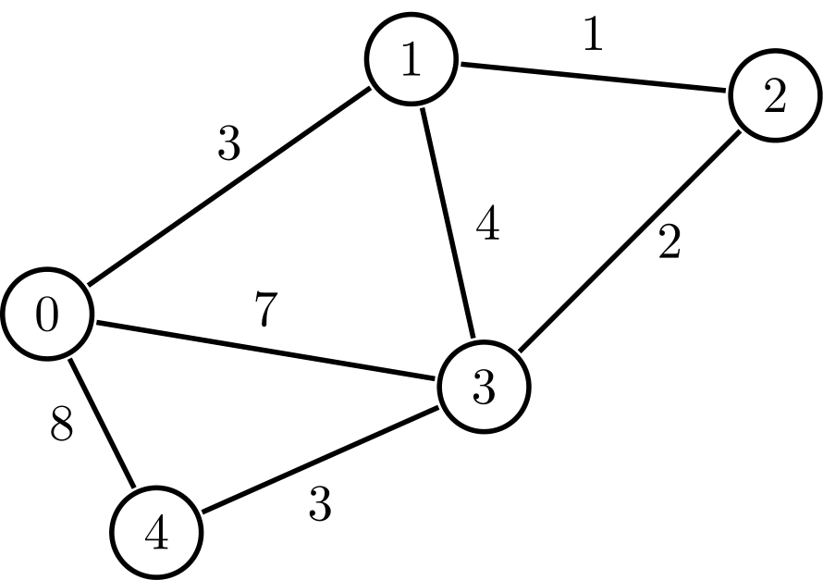
Now consider a weighted graph given as :
From this we can get a number of different
weights spanning trees. But we want out the
tree with minimum cost and thus minimum
spanning tree.
Now this can be achieved through two processes :
BRUTE-FORCE
GREEDY-ALGORITHM
PRIM’S
KRUSKAL’S

Slide 27
PRIM’S ALGORITHM

Slide 28
INTRODUCTION
The idea is to maintain two sets of vertices. The first set contains the vertices already included in the MST, the other set contains the vertices not yet included.
At every step, it considers all the edges that connect the two sets, and picks the minimum weight edge from these edges.
After picking the edge, it moves the other endpoint of the edge to the set containing MST.

Slide 29
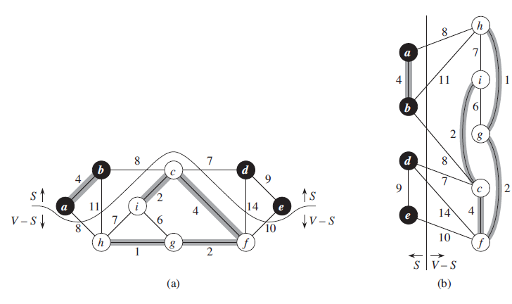
A group of edges that connects two set of vertices in a graph is called cut in graph
theory.
At every step of Prim’s algorithm, we find a cut (of two sets, one contains the
vertices already included in MST and other contains rest of the vertices).
Pick the minimum weight edge from the cut and include this vertex to MST Set.
(The set that contains already included vertices).
Notes:
vertices already included in MST and other contains rest of the vertices
(the set that contains already included vertices).

Slide 30
In order to implement Prim’s algorithm efficiently, we need a fast way to select a new edge to add to the tree formed by the edges in A.
The connected graph G and the root r of the minimum spanning tree to be grown are inputs to the algorithm.
During execution of the algorithm, all vertices that are not in the tree reside in a min-priority queue Q based on a key attribute.
For each vertex v, the attribute v.key is the minimum weight of any edge connecting v to a vertex in the tree; by convention v.key = ∞ if there is no such edge.
The attribute v.π names the parent of in the tree.

Slide 31
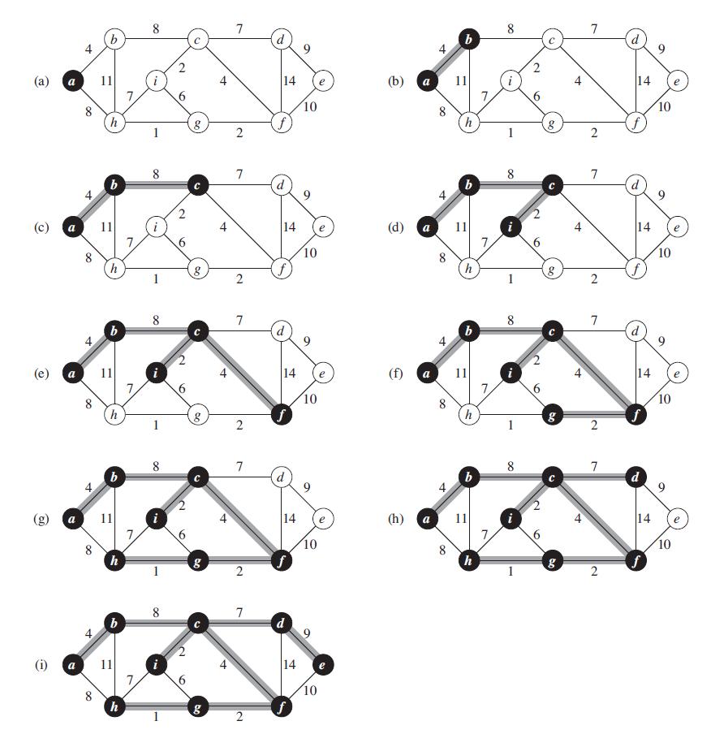
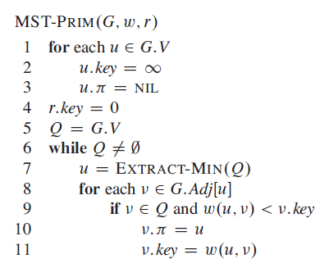

Slide 32
KRUSKAL’S ALGORITHM

Slide 33
introduction
Kruskal's algorithm is a minimum-spanning-tree algorithm which finds an edge of the least possible weight that connects any two trees in the forest. It is a greedy algorithm in graph theory as it finds a minimum spanning tree for a connected weighted graph adding increasing cost arcs at each step.
Below are the steps for finding MST using Kruskal’s algorithm :
Sort all the edges in non-decreasing order of their weight.
Pick the smallest edge. Check if it forms a cycle with the spanning tree formed so far. If cycle is not formed, include this edge. Else, discard it.
Repeat step#2 until there are (V-1) edges in the spanning tree.

Slide 34
It uses a disjoint-set data structure to maintain several disjoint sets of elements.
The operation FIND-SET(u) returns a representative element from the set that contains u.
We can determine whether two vertices u and v belong to the same tree by testing whether FIND-SET(u) equals FIND-SET(v).
To combine trees, Kruskal’s algorithm calls the UNION procedure.

Slide 35
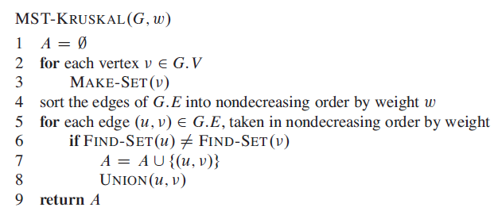

Slide 36
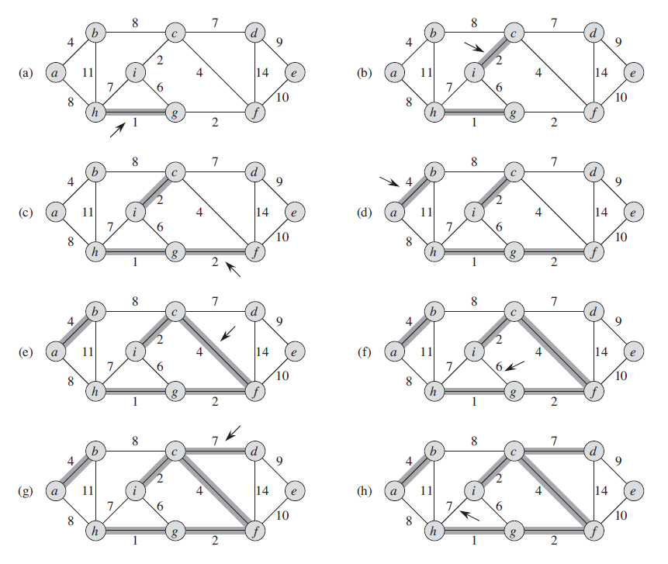

Slide 37
Single-source shortest path
In graph theory, the shortest path problem is the problem of finding a path between two vertices (or nodes) in a graph such that the sum of the weights of its constituent edges is minimized.
Definition→ In a shortest-paths problem, we are given a weighted, directed graph G(V, E), with weight function w : E → R, mapping edges to real-valued weights.
The weight w(p) of path p = {v₀, v₁, …, v_{k}} is the sum of the weights of its constituent edges:
w(p) = ∑^{k}_{i=1} w(v_{i-1,} v_{i})
We define the shortest path weight from u to v,
= min{w(p) : u ~> v}, if there is path from u to v
∞ , otherwise

Slide 38
The algorithm for the single-source problem can solve many other problems, including the following variants :
Single Destination Shortest Path Problem : Find a shortest path from the given destination vertex t to the vertex v. By reversing the direction of each edge in the graph we can reduce each problem to single-source problem.
Single Pair Shortest Path Problem : Find a shortest path from u to v for given vertices u and v. If we solve the single-source problem with source vertex u, we solve this problem also.
All Pair Shortest Path Problem : Find a shortest path from u to v for every pair of vertices of u and v. Although we can solve this problem by running a single-source algorithm once from each vertex, we usually can solve it faster.

Slide 39
Dijkstra’s algorithm

Slide 40
introduction
Dijkstra's algorithm (or Dijkstra's Shortest Path First algorithm, SPF algorithm) is an algorithm for finding the shortest paths between nodes in a graph, which may represent, for example, road networks.
We generate a SPT (shortest path tree) with given source as root. We maintain two sets, one set contains vertices included in shortest path tree, other set includes vertices not yet included in shortest path tree.
At every step of the algorithm, we find a vertex which is in the other set (set of not yet included) and has a minimum distance from the source.

Slide 41
ALGORITHM
Dijkstra’s algorithm solves the single-source shortest-paths problem on a weighted, directed graph G(V, E) for the case in which all edge weights are nonnegative.
Below are the detailed steps used in Dijkstra’s algorithm to find the shortest path from a single source vertex to all other vertices in the given graph.
Dijkstra’s Algorithm maintains a set S of vertices whose final shortest path weights from the source s has already been determined.
The algorithm repeatedly selects the vertex u ϵ V-S with minimum shortest path estimate, adds u to S, and relaxes all edges leaving u.
In the following implementation, we use a min-priority queue Q of vertices, keyed by their d value.

Slide 42
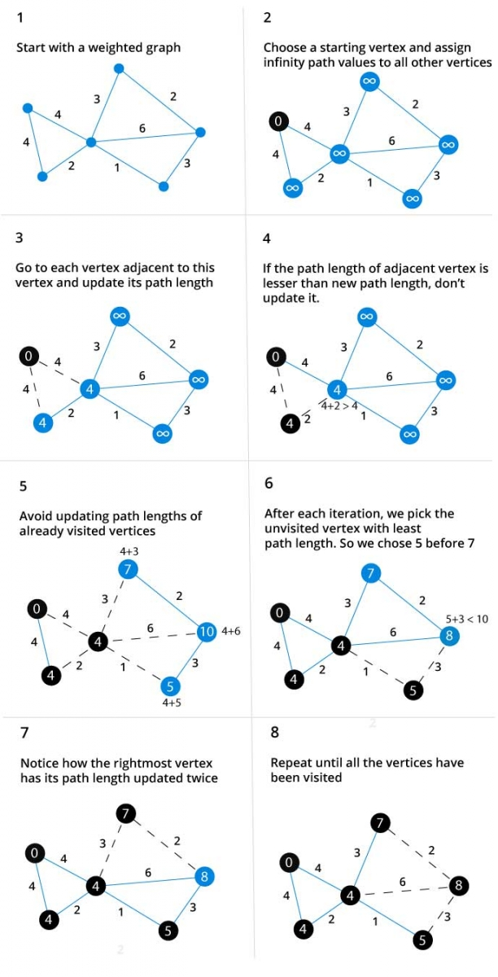
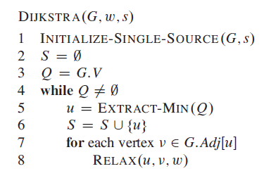

Slide 43
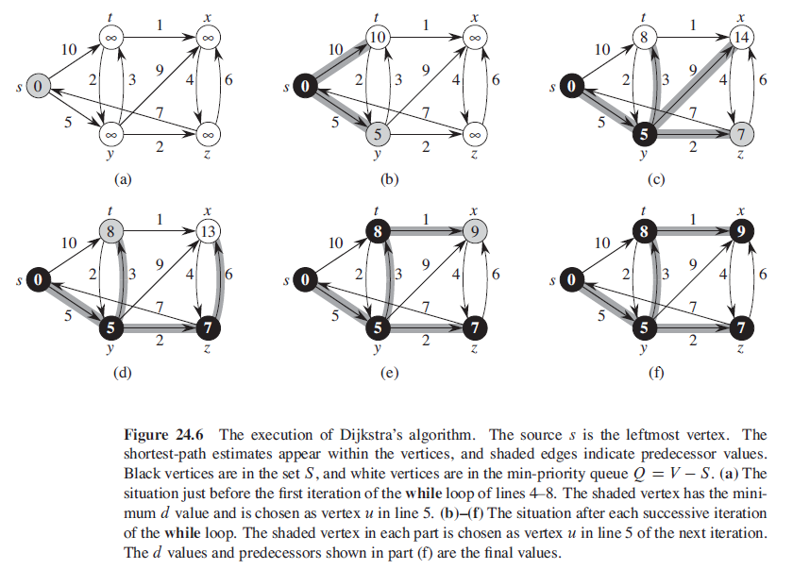

Slide 44
Bellman-ford algorithm

Slide 45
introduction
The Bellman–Ford algorithm is an algorithm that computes shortest paths from a single source vertex to all of the other vertices in a weighted digraph.
Negative edge weights are found in various applications of graphs, hence the usefulness of this algorithm.
If a graph contains a "negative cycle" (i.e. a cycle whose edges sum to a negative value) that is reachable from the source, then there is no cheapest path: any path that has a point on the negative cycle can be made cheaper by one more walk around the negative cycle. In such a case, the Bellman–Ford algorithm can detect and report the negative cycle.

Slide 46
ALGORITHM
Like Dijkstra's algorithm, Bellman–Ford proceeds by relaxation, in which approximations to the correct distance are replaced by better ones until they eventually reach the solution.
In both algorithms, the approximate distance to each vertex is always an overestimate of the true distance, and is replaced by the minimum of its old value and the length of a newly found path.
Dijkstra's algorithm uses a priority queue to greedily select the closest vertex that has not yet been processed, and performs this relaxation process on all of its outgoing edges; by contrast, the Bellman–Ford algorithm simply relaxes all the edges, and does
this |V|-1 times, where |V| is the number of vertices in the graph.
Bellman Ford runs in O(|V|*|E|) time, where |V| and |E| are the total number of vertices and edges respectively.

Slide 47
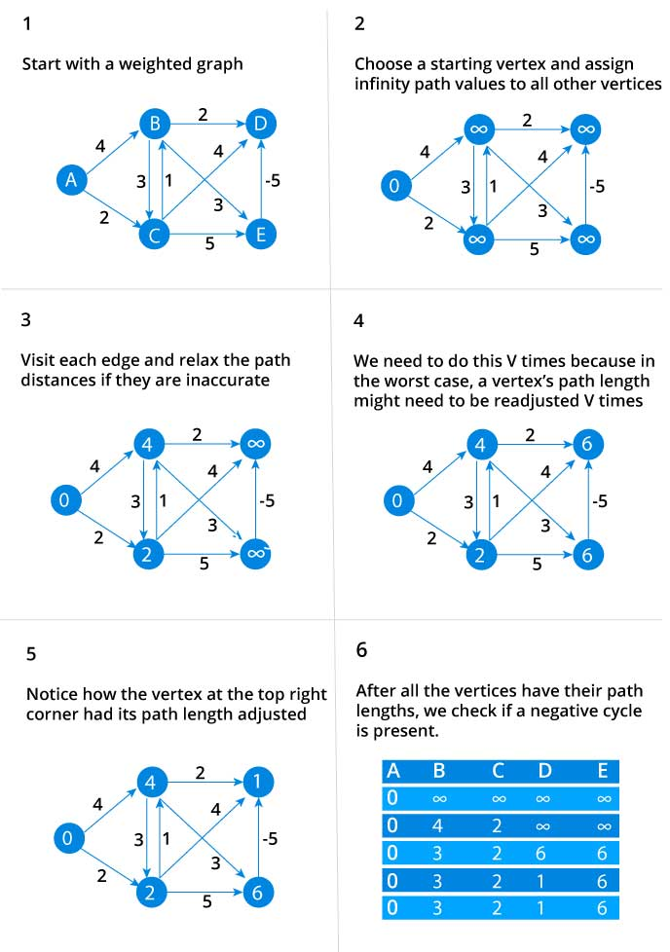
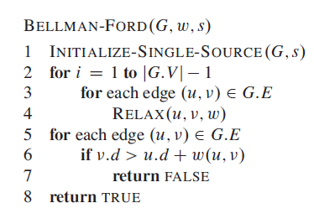

Slide 48
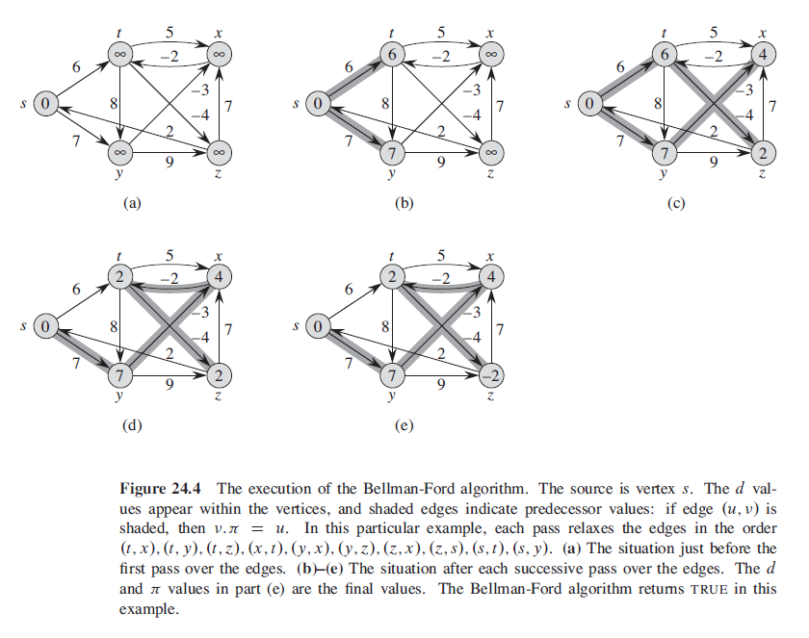

Slide 49
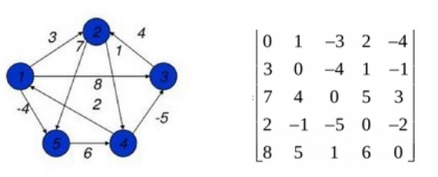
ALL-PAIR SHORTEST PATH ALGORITHM
The all pair shortest path algorithm is also known as Floyd - Warshall algorithm is used to find all pair shortest path problem from a given weighted graph.
As a result of this algorithm, it will generate a matrix, which will represent the minimum distance from any node to all other nodes in the graph.

Slide 50
FLOYD-WARSHALL ALGORITHM

Slide 51
INTRODUCTION
We can solve an all-pairs shortest-paths problem by running a single-source shortest-paths algorithm |V| times, once for each vertex as the source.
Unlike the single-source algorithms, which assume an adjacency-list representation of the graph, Floyd – Warshall algorithm uses an adjacency matrix representation.
We assume that the vertices are numbered 1, 2, 3, …, |V| so that the input is an n × n matrix W representing the edge weights of an n-vertex directed graph G(V, E).
The tabular output of the all-pairs shortest-paths algorithms is an n × n matrix D = (d_{ij}) where entry d_{ij} contains the weight of a shortest path from vertex i to vertex j .

Slide 52
ALGORITHM
To solve the all-pairs shortest-paths problem on an input adjacency matrix, we need to compute not only the shortest-path weights but also a predecessor matrix П = (π_{ij}) where π_{ij} = NIL, if i = j or there’s no path from i to j, otherwise π_{ij} is the predecessor of j on some shortest path from i.
For each vertex, i ϵ V, we define the predecessor subgraph of G for i as G_{π, i} = (V_{π, i} , E_{π, i}), where
V_{π, i} = {j ϵ V : π_{ij} ≠ NIL} U {i}
and,
E_{π, I} = {(π_{ij} , j) : j ϵ V_{π, i} - {i}}

Slide 53
